Slide 1

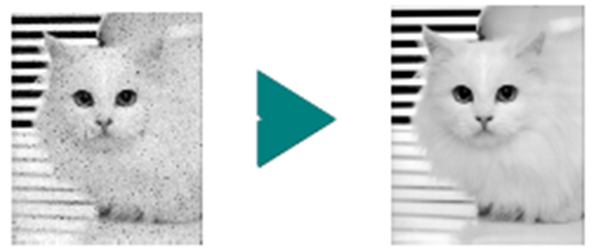
Image Enhancement in the Spatial Domain

Slide 2
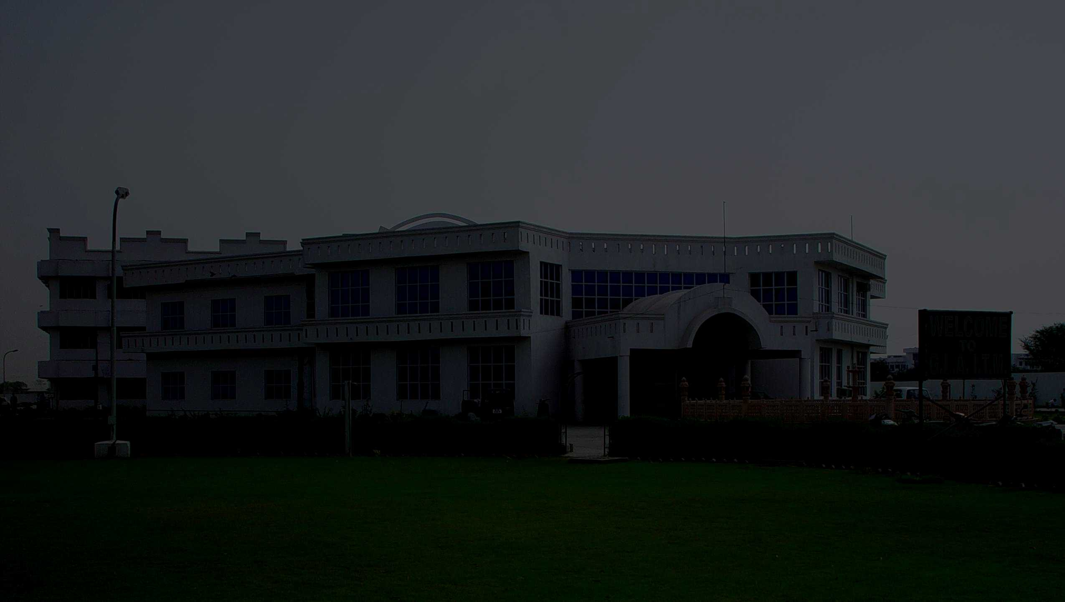
Image is NOT Perfect Sometimes

Slide 3
What Is Image Enhancement?
Image enhancement is the process of making images more useful.
The reasons for doing this include:
Making images more visually appealing
Highlighting interesting details in images
Removing noise from images

Slide 4
Why do we need Image Enhancement?
The goal of image enhancement is to process a digital image and make it more “suitable” than the original image for a specific application
Images may suffer from the following degradations:
Poor contrast due to poor illumination or finite sensitivity of the imaging device
Electronic sensor noise or atmospheric disturbances leading to broad band noise
Aliasing effects due to inadequate sampling
Finite aperture effects or motion

Slide 5
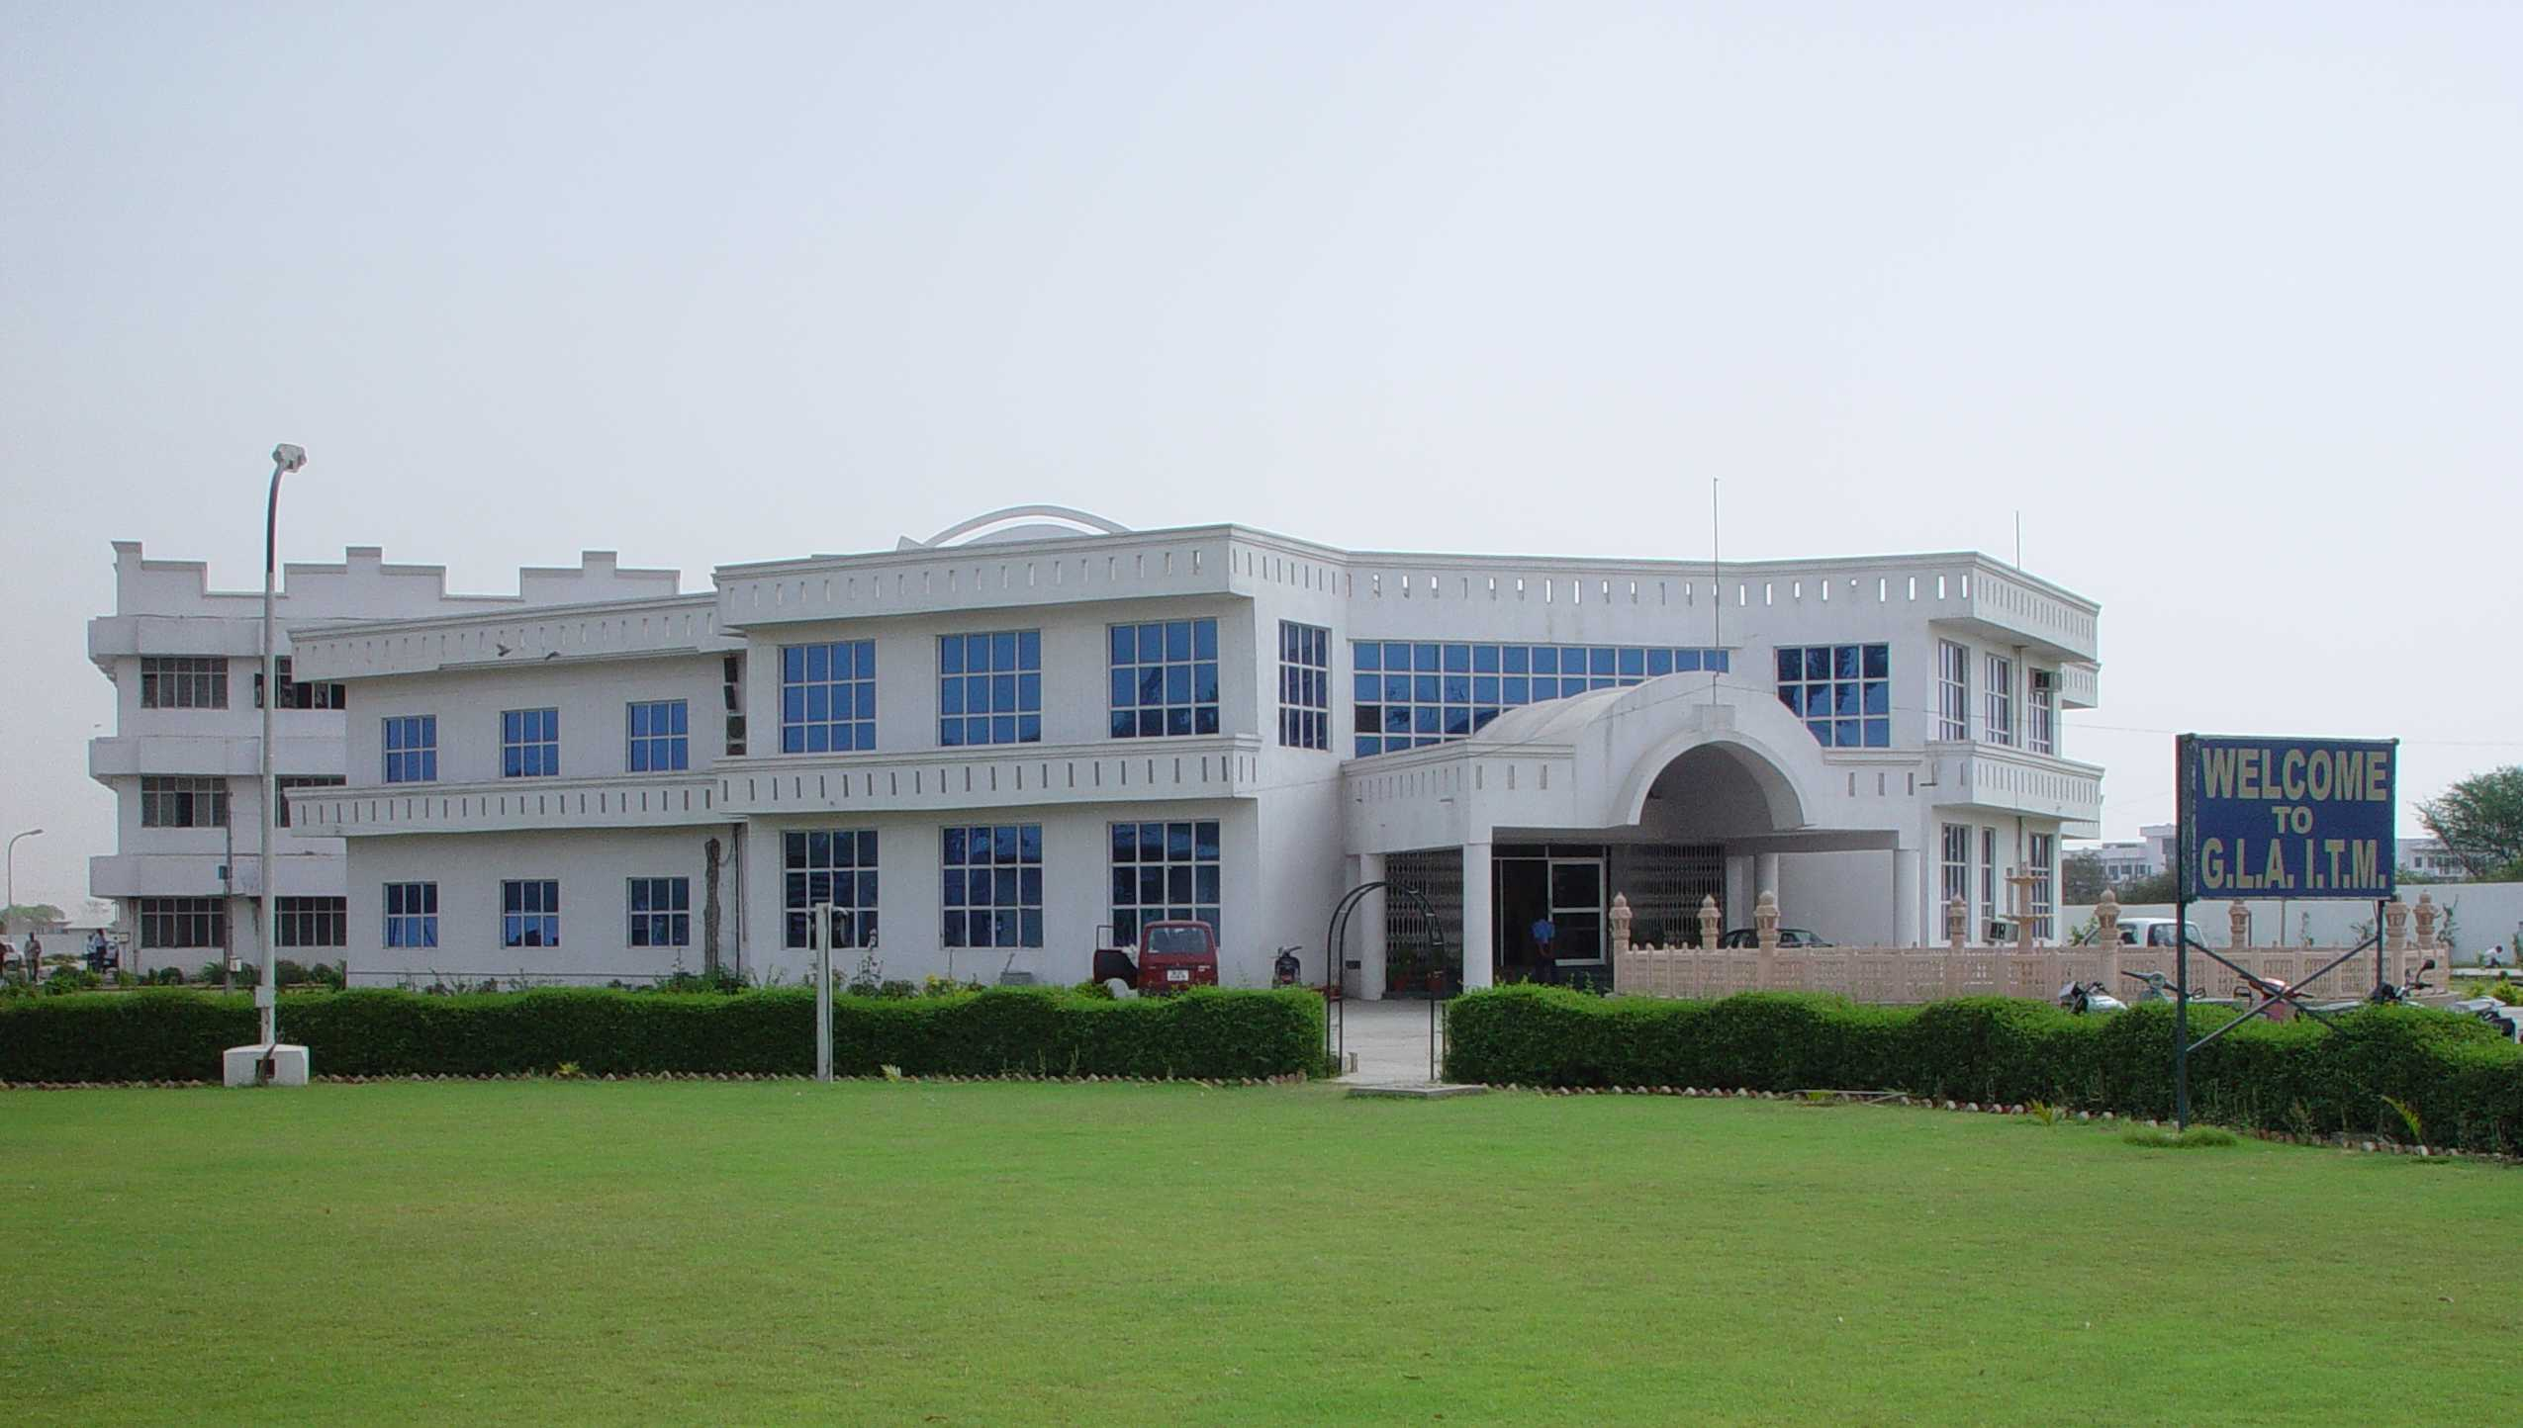
After Image Enhancement

Slide 6
Image Enhancement
There are Two broad categories of Image Enhancement Approaches
Spatial domain methods
Based on direct manipulation of pixels in an image
Frequency domain methods
Based on modifying the Fourier transform of an image

Slide 7
Spatial Domain
Intensity Transformations (Point processing)
Operate on single pixels of an image
e.g., image averaging; logic operation; contrast stretching ...
Spatial Filtering (Mask processing)
Working in a neighbourhood of every pixel in an image
e.g., blurring, median

Slide 8
Good Images
For human visual
The visual evaluation of image quality is a highly subjective process.
It is hard to standardize the definition of a good image.
For machine perception
The evaluation task is easier.
A good image is one which gives the best machine recognition results.
A certain amount of trial and error usually is required before a particular image enhancement approach is selected.

Slide 9
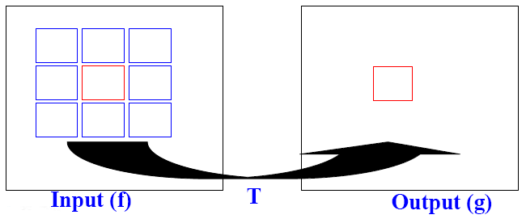
Spatial Domain
Spatial domain can be denoted by:
g(x,y) = T[f(x,y)]
where
f(x,y) is the input image
g(x,y) is the processed image
T is an operator on f defined over some neighborhood of (x,y)

Slide 10
Intensity Transformations (Point processing)

Slide 11
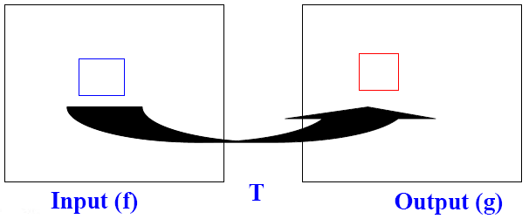
Intensity Transformation
Simplest T : operates on neighborhood of 1x1
Then, it becomes intensity transformation
g depends on only the value of f at (x,y)
T = gray level (or intensity or mapping) transformation function
s = T(r)
Where
r = gray level of f(x,y)
s = gray level of g(x,y)

Slide 12
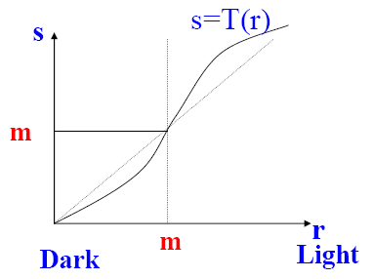
Intensity Transformation …
The gray level below m are darkened and the levels above m are brightened.

Slide 13
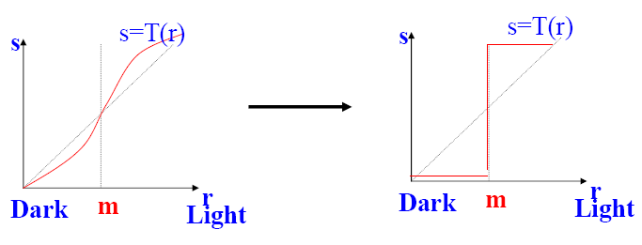
Intensity Transformation …
Limiting case: Produces a binary image (two level) from input image and the function is known as Thresholding function
g(x,y) = L if f(x,y) > m,
0 otherwise

Slide 14
Basic Intensity Transformation Functions
Linear function
Negative and identity transformations
Logarithm function
Log and inverse-log transformation
Power-law function
n^{th} power and n^{th} root transformations
Negative
nth root
Log
nth power
Output gray level, s
Identity
Inverse Log
Input gray level, r
Identity function: Output intensities are identical to input intensities.
Notes:
The Identity and Negative curves fall under the category of linear functions. Identity curve simply indicates that input image is equal to the output image. The Log and Inverse-Log curves fall under the category of Logarithmic functions and nth root and nth power transformations fall under the category of Power-Law functions.

Slide 15
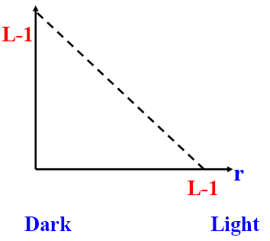
Image Negatives
An image with gray level in the range [0, L-1] where L = 2^{n} ; n = 1, 2…
Negative transformation :
s = L – 1 –r
Reversing the intensity levels of an image.
Suitable for enhancing white or gray detail embedded in dark regions of an image, especially when the black area dominant in size.

Slide 16
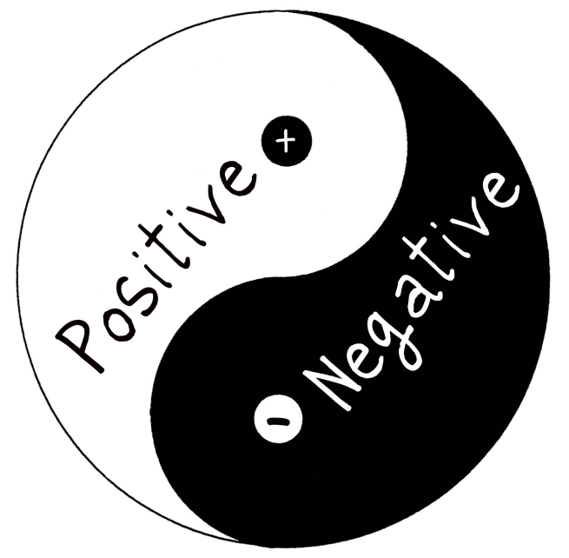
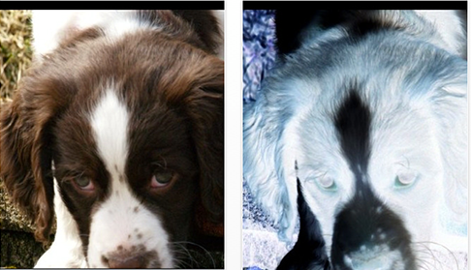
Image Negatives

Slide 17
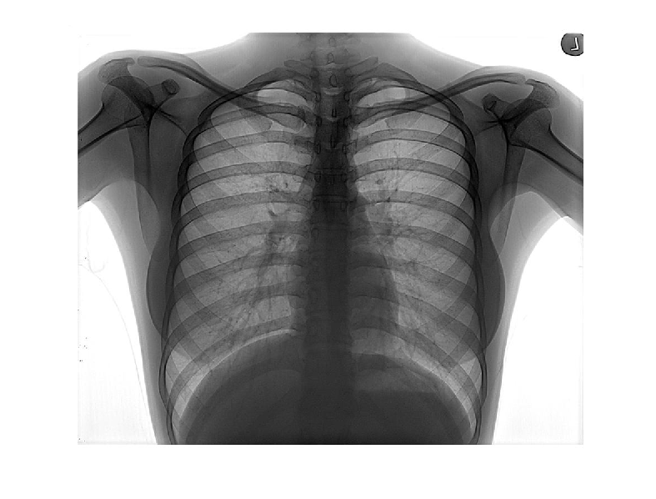
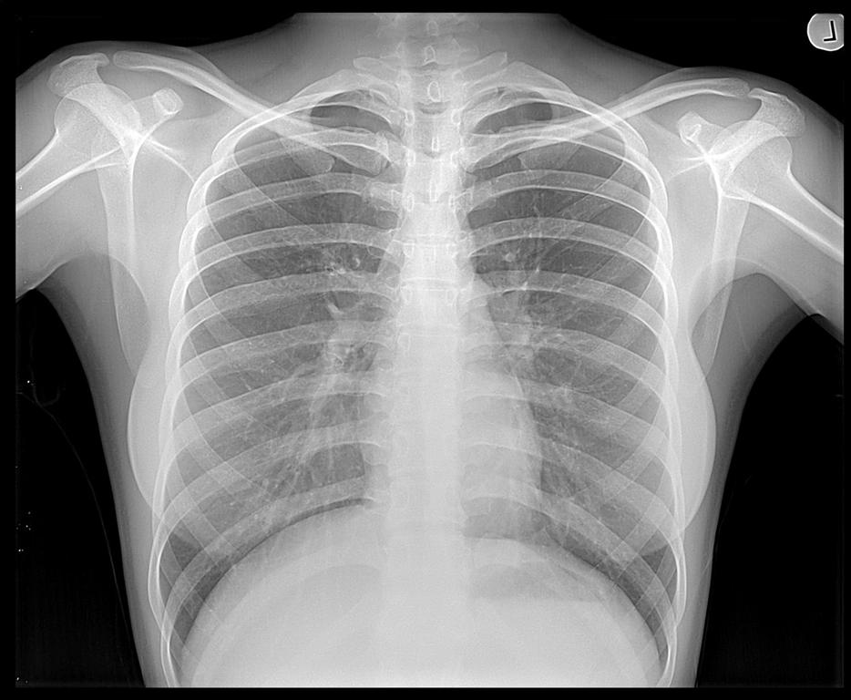
Image Negatives: Example

Slide 18
Log Transformations
s = c log (1+r)
c is a constant and r ≥ 0
Log curve maps a narrow range of low gray-level values in the input image into a wider range of output levels.
Used to expand the values of dark pixels in an image while compressing the higher-level values.
Negative
nth root
Log
nth power
Output gray level, s
Identity
Inverse Log
Input gray level, r
Notes:
this transformation maps a narrow range of low-level grey scale intensities into a wider range of output values. And similarly maps the wide range of high-level grey scale intensities into a narrow range of high level output values. The opposite of this applies for inverse-log transform. This transform is used to expand values of dark pixels and compress values of bright pixels.

Slide 19
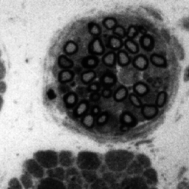
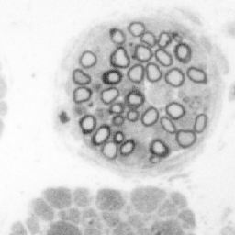
Log Transformations: Example
Original Image
Mapped image

Slide 20
Example of Logarithm Image
Fourier Spectrum with range = 0 to 1.5 x 10⁶
Result after apply the log transformation with c = 1, range = 0 to 6.2

Slide 21
Power-Law Transformations
s = cr^{γ}
c and γ are positive constants
Power-law curves with fractional values of γ map a narrow range of dark input values into a wider range of output values, with the opposite being true for higher values of input levels.
c = γ = 1  Identity function
Output gray level, s
Input gray level, r
Plots of s = cr^{γ} for various values of γ
(c = 1 in all cases)
Notes:
This transformation function is also called as gamma correction. For various values of γ different levels of enhancements can be obtained. This technique is quite commonly called as Gamma Correction. If you notice, different display monitors display images at different intensities and clarity. That means, every monitor has built-in gamma correction in it with certain gamma ranges and so a good monitor automatically corrects all the images displayed on it for the best contrast to give user the best experience.
The difference between the log-transformation function and the power-law functions is that using the power-law function a family of possible transformation curves can be obtained just by varying the λ.

Slide 22
Example : MRI
a)
b)
(a) a magnetic resonance image of an upper thoracic human spine with a fracture dislocation and spinal cord impingement
The picture is predominately dark
An expansion of gray levels are desirable  needs γ < 1
(b) result after power-law
transformation with γ = 0.6, c=1
(c) transformation with γ = 0.4
(best result)
(d) transformation with γ = 0.3
(under acceptable level)
c)
d)

Slide 23
Effect of decreasing gamma
When the γ is reduced too much, the image begins to reduce contrast to the point where the image started to have very slight “wash-out” look, especially in the background
(a) image has a washed-out appearance, it needs a compression of gray levels  needs γ > 1
(b) result after power-law
transformation with γ = 3.0 (suitable)
(c) transformation with γ = 4.0
(suitable)
(d) transformation with γ = 5.0
(high contrast, the image has areas that are too dark, some detail is lost)
a)
b)
c)
d)
Notes:
These are the three basic image enhancement functions for grey scale images that can be applied easily for any type of image for better contrast and highlighting. Using the image negation formula given above, it is not necessary for the results to be mapped into the grey scale range [0, L-1]. Output of L-1-r automatically falls in the range of [0, L-1]. But for the Log and Power-Law transformations resulting values are often quite distintive, depending upon control parameters like λ and logarithmic scales. So the results of these values should be mapped back to the grey scale range to get a meaningful output image. For example, Log function s = c log(1 + r) results in 0 and 2.41 for r varying between 0 and 255, keeping c=1. So, the range [0, 2.41] should be mapped to [0, L-1] for getting a meaningful image.

Slide 24
Piecewise-Linear Transformation Functions
A complementary approach to the previous methods
The form of piecewise functions can be arbitrarily complex
Practical implementation of some important transformations can be formulated only as piecewise functions
Their specification requires considerably more user input

Slide 25
Contrast Stretching
The Simplest of piecewise linear functions.
Basic idea – to increase the dynamic range of the gray levels in the image being processed.
During image acquisition, low contrast images may result due to
Poor illumination
Lack of dynamic range in image sensor
Wrong setting of the lens aperture

Slide 26
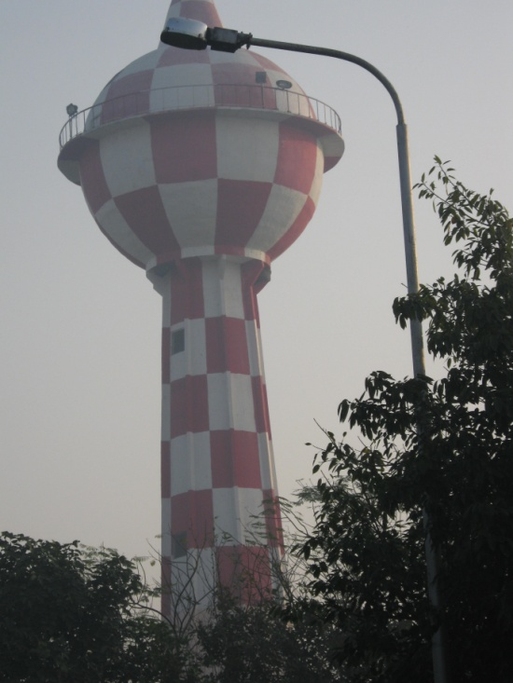
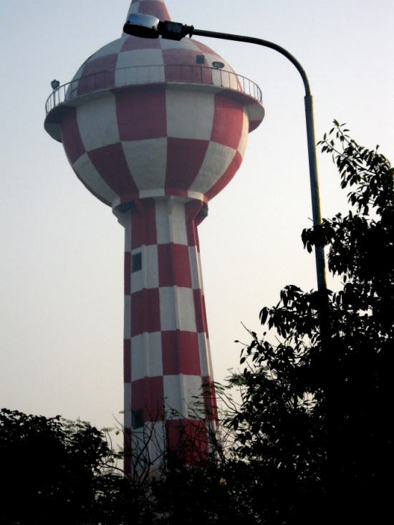
Contrast Stretching
Contrast transform result
Original
Enhanced

Slide 27
Contrast Stretching: Example
increase the dynamic range of the gray levels in the image
(b) a low-contrast image
(c) result of contrast stretching: (r₁,s₁) = (r_{min},0) and (r₂,s₂) = (r_{max},L-1)
(d) result of thresholding

Slide 28
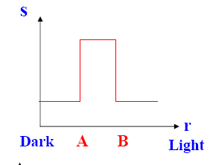
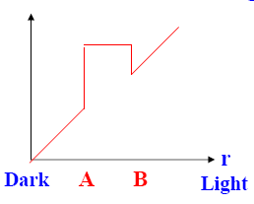
Gray-level slicing
Highlight a specific range of gray values
Two basic Methods
Display a high value for all gray levels in the range of interest and a low value for all other
Brighten the desired range of gray levels but preserve all other levels

Slide 29
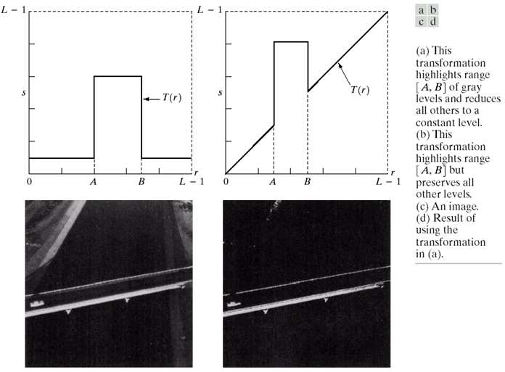
Gray-level slicing: Example

Slide 30
Bit-plane slicing
Highlighting the contribution made to total image appearance by specific bits
Suppose each pixel is represented by 8 bits
Higher-order bits contain the majority of the visually significant data
Useful for analyzing the relative importance played by each bit of the image
One 8-bit byte
Bit-plane 7
(most significant)
Bit-plane 0
(least significant)
Notes:
Separating a digital image into its bit planes is useful for analyzing the relative importance played by each bit of the image, implying, it determines the adequacy of numbers of bits used to quantize each pixel , useful for image compression.

Slide 31
Bit-plane slicing: Example
Higher order bit planes of an image carry a significant amount of visually relevant details.
Lower order planes contribute more to fine (often imperceptible) details.
The (binary) image for bit-plane 7 can be obtained by processing the input image with a thresholding gray-level transformation.
Map all levels between 0 and 127 to 0
Map all levels between 129 and 255 to 255
An 8-bit fractal image

Slide 32
Bit-plane slicing: Example (8 bit planes)
Bit-plane 7 |  | Bit-plane 6
Bit-plane 5 | Bit-plane 4 |  | Bit-plane 3
Bit-plane 2 | Bit-plane 1 |  | Bit-plane 0

Slide 33
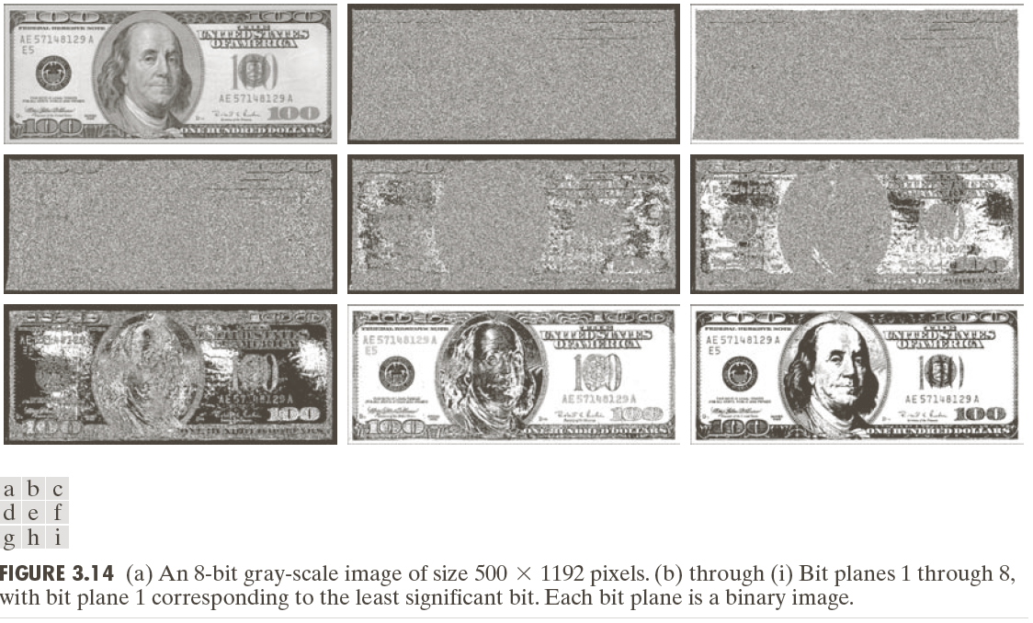
Bit-plane slicing: Example

Slide 34
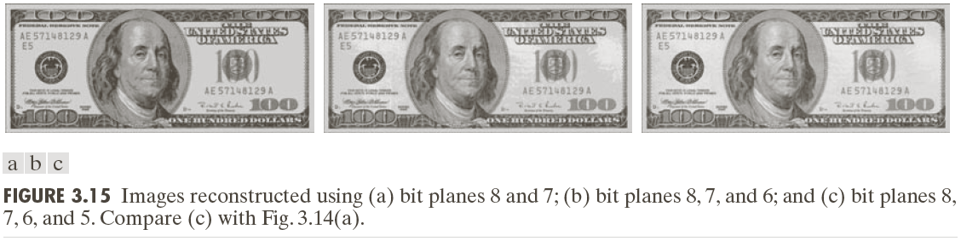
Bit-plane slicing: Example

Slide 35
Histogram Processing
Histogram is a discrete function formed by counting the number of pixels that have a certain gray level in the image .
Histogram of a digital image with gray levels in the range [0,L-1] is a discrete function
h(r_{k}) = n_{k}
Where
r_{k} : the k^{th} gray level
n_{k} : the number of pixels in the image having gray level r_{k}
h(r_{k}) : histogram of a digital image with gray levels r_{k}

Slide 36
Histogram Processing: Example
No. of pixels
6
2 | 3 | 3 | 2
4 | 2 | 4 | 3
3 | 2 | 3 | 5
2 | 4 | 2 | 4
5
4
3
2
1
Gray level
4x4 image
0
1
2
3
4
5
6
7
8
9
Gray scale = [0,9]
histogram

Slide 37
Normalized Histogram
Dividing each of histogram at gray level r_{k} by the total number of pixels in the image, n
p(r_{k}) = n_{k} / n
For k = 0,1,…,L-1
p(r_{k}) gives an estimate of the probability of occurrence of gray level r_{k}
The sum of all components of a normalized histogram is equal to 1

Slide 38
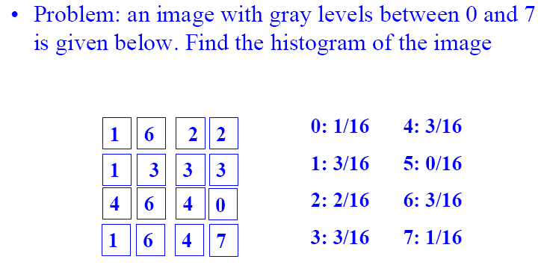
Histogram Processing: Example

Slide 39
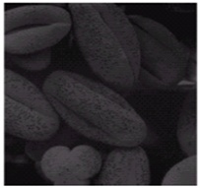
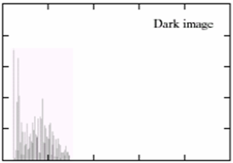
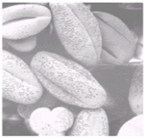
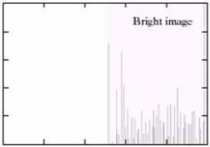
Histogram Processing: Example
In the dark images, components of the histogram are concentrated on the low (dark) side of the gray scale.
In bright images, the histogram is biased towards the high side of the gray scale.

Slide 40
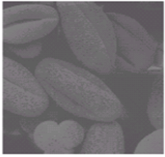
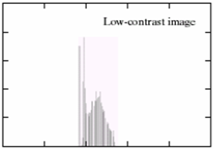
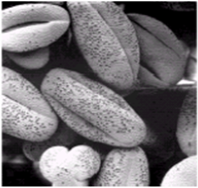
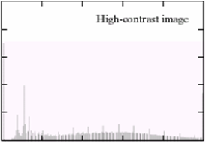
Histogram Processing: Example
In image with low contrast, the histogram will be narrow & centred towards the middle of the gray scale.
An image with high contrast & a large variety of gray tones will have pixels that occupy the entire range of possible gray levels & are uniformly distributed.

Slide 41
Histogram Equalization OR Histogram Linearization
It is the process that transforms the intensity values so that the histogram of the output image approximately matches the flat (uniform) histogram.
The aim is to create an image with equally distributed brightness levels over the whole brightness scale.

Slide 42
Histogram Equalization OR Histogram Linearization
As the low-contrast image’s histogram is narrow and centered toward the middle of the gray scale, if we distribute the histogram to a wider range the quality of the image will be improved.
We can do it by adjusting the probability density function of the original histogram of the image so that the probability spread equally.
Histogram equalization (HE) results are similar to contrast stretching but offer the advantage of full automation, since HE automatically determines a transformation function to produce a new image with a uniform histogram.
Notes:
VARIANCE and STANDARD DEVIATION of the histogram tell us about the average contrast of the image !
The higher the VARIANCE (=the higher the STANDARD DEVIATION), the higher the image’s contrast !

Slide 43
Histogram Equalization
Goal: find a transform s=T(r) such that the transformed image has a flat (equalized) histogram.
Where T(r) satisfies the following conditions:
T(r) is single-valued and monotonically increasing in interval [0,1];
0≤T(r) ≤1 for 0 ≤r ≤1.
Notes:
The method is useful in images with backgrounds and foregrounds that are both bright or both dark. In particular, the method can lead to better views of bone structure in x-ray images, and to better detail in photographs that are over or under-exposed.
A key advantage of the method is that it is a fairly straightforward technique and an invertible operator. So in theory, if the histogram equalization function is known, then the original histogram can be recovered. The calculation is not computationally intensive. A disadvantage of the method is that it is indiscriminate. It may increase the contrast of background noise, while decreasing the usable signal.

Slide 44
Histogram Equalization …
For discrete values, the probability of occurrence of gray level r_{k} in an image is given by:
P_{r}(r_{k}) = n_{k} / n
where k = 0, 1, …, L-1,
n is the total no. of pixels in the image
n_{k} is the no. of pixels with gray level r_{k}
L is the total no. of possible gray levels in the image

Slide 45
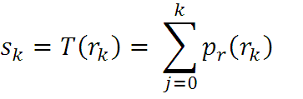
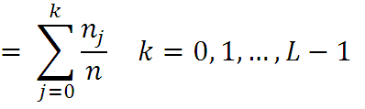
Histogram Equalization …
The discrete transformation function is given by:
The o/p image is obtained by mapping each pixel with level r_{k} in the i/p image into a corresponding pixel with level s_{k} in the o/p image with the help of the above equation.

Slide 46
Histogram Equalization …
The following equations bring back the gray levels in the range [0, L-1]
M – no. of rows
N – no. of columns
MN – total no. of pixels in the image

Slide 47
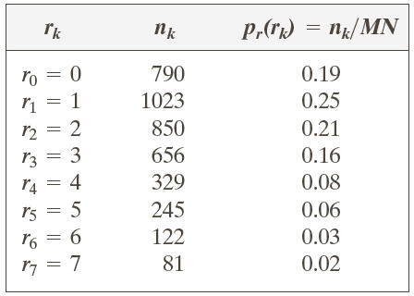
Histogram Equalization: Example
Suppose that a 3-bit image (L=8) of size 64 × 64 pixels (MN = 4096) has the intensity distribution shown in following table.
Get the histogram equalization transformation function and give the p_{s}(s_{k}) for each s_{k}.

Slide 48
Histogram Equalization: Example …
I/p Gray Level (r_{k}) | no. of pixels (n_{k}) | p(r_{k}) = n_{k}/MN | Σ | (L-1)Σ | O/p Gray Level (s)
0 | 790 | 0.19 | 0.19 | 1.33 | 1
1 | 1023 | 0.25 | 0.44 | 3.08 | 3
2 | 850 | 0.21 | 0.65 | 4.55 | 5
3 | 656 | 0.16 | 0.81 | 5.67 | 6
4 | 329 | 0.08 | 0.89 | 6.23 | 6
5 | 245 | 0.06 | 0.95 | 6.65 | 7
6 | 122 | 0.03 | 0.98 | 6.86 | 7
7 | 81 | 0.02 | 1.00 | 7.00 | 7

Slide 49
Grey level | n_{k} | p_{r}(r_{k}) | s_{k}
0 | 790 | 0.19 | 1
1 | 1023 | 0.25 | 3
2 | 850 | 0.21 | 5
3 | 656 | 0.16 | 6
4 | 329 | 0.08 | 6
5 | 245 | 0.06 | 7
6 | 122 | 0.03 | 7
7 | 81 | 0.02 | 7
What will be the histogram of the new image?
Equalized Grey level | n_{k}
0 | 0
1 | 790
2 | 0
3 | 1023
4 | 0
5 | 850
6 | 656 + 329 = 985
7 | 245 + 122 + 81 = 448

Slide 50
Histogram of the dark image
Equalized Histogram of the image

Slide 51
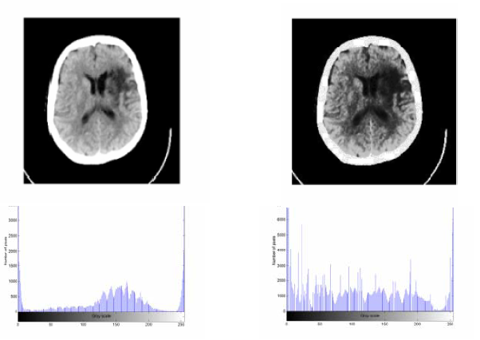
Histogram Equalization: Example
Before HE
After HE

Slide 52
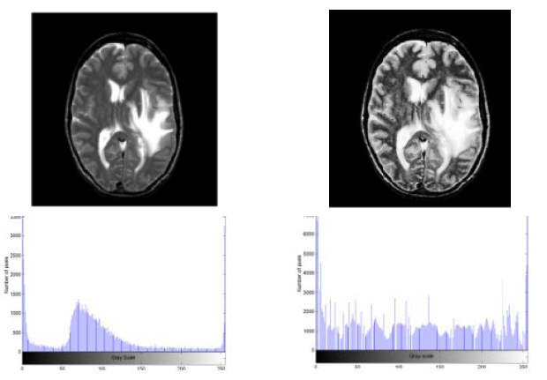
Histogram Equalization: Example
Before HE
After HE

Slide 53
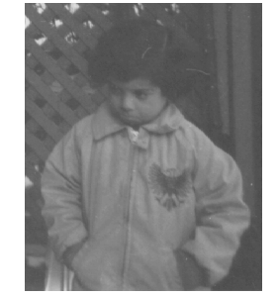
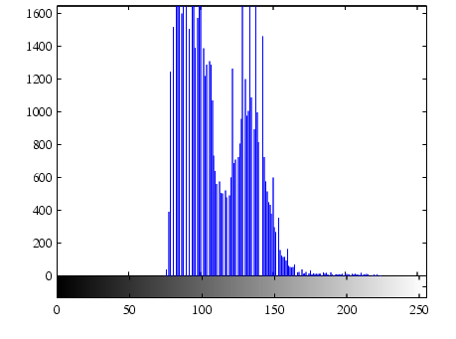
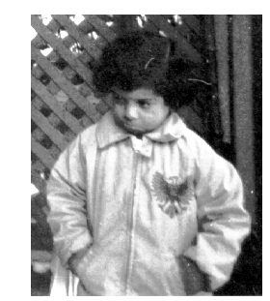
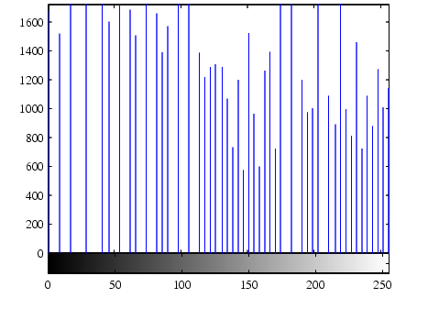
Histogram Equalization: Example

Slide 54
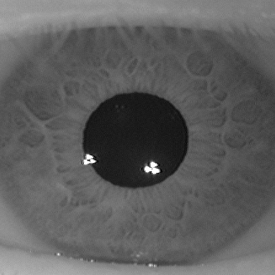
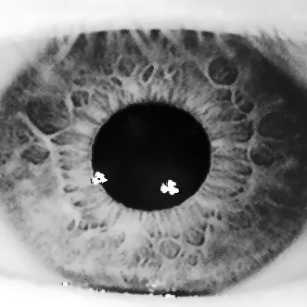
Histogram Equalization: Example
before
after

Slide 55
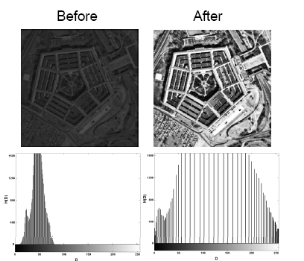
Histogram Equalization: Example
Aerial photograph of the Pentagon.

Slide 56
Histogram Matching (Specification)
Histogram equalization has a disadvantage which is that it can generate only one type of output image.
Sometimes it is useful to be able to specify the shape of the histogram that we wish the processed image to have.
With Histogram Specification, we can specify the shape of the histogram that we wish the output image to have.
It doesn’t have to be a uniform histogram
Notes:
Histogram specification is a trial-and-error process
There are no rules for specifying histograms, and one must resort to analysis on a case-by-case basis for any given enhancement task.

Slide 57
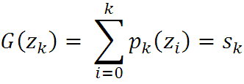
Histogram Matching (Specification) …
For an image, whose enhancement is to be done, we are given an histogram, G(z_{k}), that actually shows how the processed image’s histogram should look after applying the transformation function to the i/p image.
s_{k} = T(r_{k})
z_{k} = G⁻¹(s_{k}) = G⁻¹[T(r_{k})]
k = 0, 1, …, L-1

Slide 58
Histogram Matching (Specification) …
Step 1: Find histogram of input image p_{r}(rj) , and find histogram equalization mapping.
Step 2: Specify the desired histogram, and find histogram equalization mapping.
Step 3: Build lookup table:
For each gray level k, find s_{k} and then find a l level so that s_{k} best matches z_{l}:
min|s_{k}-z_{l}|
setup a lookup entry lookup[k]=l.

Slide 59
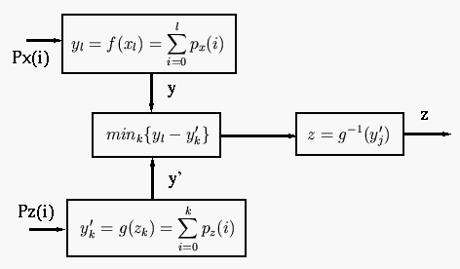
Histogram Matching: Discrete Cases

Slide 60
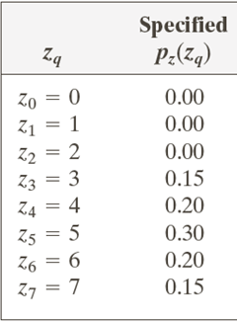
Histogram Matching: Example
Suppose that a 3-bit image (L=8) of size 64 × 64 pixels (MN = 4096) has the intensity distribution shown in the following table (on the left). Get the histogram transformation function and make the output image with the specified histogram, listed in the table on the right.

Slide 61
We have already equalized the first histogram.
I/p Gray Level (r_{k}) | no. of pixels (n_{k}) | p(r_{k}) = n_{k}/MN | Σ | (L-1)Σ | O/p Gray Level (s)
0 | 790 | 0.19 | 0.19 | 1.33 | 1
1 | 1023 | 0.25 | 0.44 | 3.08 | 3
2 | 850 | 0.21 | 0.65 | 4.55 | 5
3 | 656 | 0.16 | 0.81 | 5.67 | 6
4 | 329 | 0.08 | 0.89 | 6.23 | 6
5 | 245 | 0.06 | 0.95 | 6.65 | 7
6 | 122 | 0.03 | 0.98 | 6.86 | 7
7 | 81 | 0.02 | 1.00 | 7.00 | 7

Slide 62
Now equalize the second histogram.
Gray Level (z_{k}) | p(z_{k}) = n_{k}/MN | Σ | (L-1)Σ | O/p Gray Level G(z_{k})
0 | 0.00 | 0 | 0 | 0
1 | 0.00 | 0 | 0 | 0
2 | 0.00 | 0 | 0 | 0
3 | 0.15 | 0.15 | 1.05 | 1
4 | 0.20 | 0.35 | 2.45 | 2
5 | 0.30 | 0.65 | 4.55 | 5
6 | 0.20 | 0.85 | 5.95 | 6
7 | 0.15 | 1 | 7 | 7

Slide 63
And now we do the matching
I/p Gray Level (r_{k}) | O/p Gray Level (s) |  | O/p Gray Level G(z_{k}) | Gray Level (z_{k})
0 | 1 |  | 0 | 0
1 | 3 |  | 0 | 1
2 | 5 |  | 0 | 2
3 | 6 |  | 1 | 3
4 | 6 |  | 2 | 4
5 | 7 |  | 5 | 5
6 | 7 |  | 6 | 6
7 | 7 |  | 7 | 7
I/p Gray Level (r_{k}) |  | Gray Level (z_{k})
0 |  | 0
1 |  | 1
2 |  | 2
3 |  | 3
4 |  | 4
5 |  | 5
6 |  | 6
7 |  | 7

Slide 64
Histogram Matching: Example

Slide 65
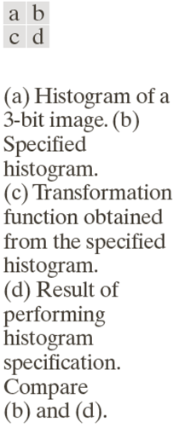
Histogram Matching: Example

Slide 66
Histogram processing yields robust image processing results
Are histograms unique ???
Histograms of both the images are same !!

Slide 67
Local Histogram Processing …
Q: What happens if I reshuffle all pixels within the image?
A: It’s histogram won’t change. No point processing will be affected…
Need spatial information to capture this.

Slide 68
Local Histogram Processing
Transformation should be based on gray-level distribution in the neighborhood of every pixel.
Local histogram processing:
At each location the histogram of the points in the neighborhood is computed and a histogram equalization or histogram specification transformation function is obtained
The gray level of the pixel centered in the neighborhood is mapped
The center of the neighborhood is moved the next pixel and the procedure repeated
Notes:
The histogram processing methods discussed so far are global , in the sense that pixels are modified by a transformation function based on the gray level content of an entire image.
Global approach suitable for overall enhancement. But there are cases where it is necessary to enhance details over small areas in the image. The no. of pixels in these areas may have negligible influence on the computation of a global transformation whose shape may not guarantee the desired local enhancement.

Slide 69
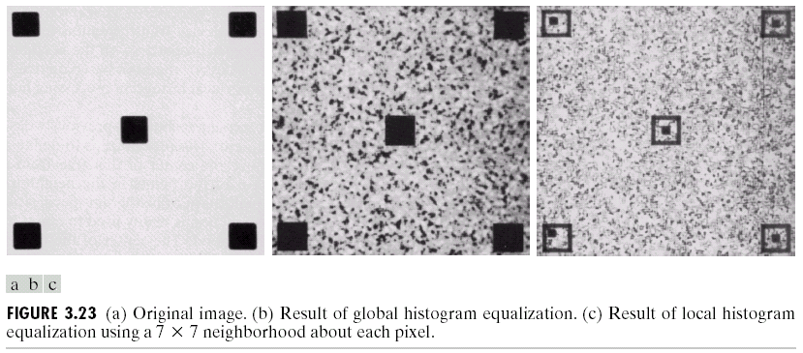
Local Histogram Processing: Example
Notes:
define a square or rectangular neighborhood and move the center of this area from pixel to pixel.
at each location, the histogram of the points in the neighborhood is computed and either histogram equalization or histogram specification transformation function is obtained.
another approach used to reduce computation is to utilize nonoverlapping regions, but it usually produces an undesirable checkerboard effect.
Basically, the original image consists of many small squares inside the larger dark ones.
However, the small squares were too close in gray level to the larger ones, and their sizes were too small to influence global histogram equalization significantly.
So, when we use the local enhancement technique, it reveals the small areas.
Note also the finer noise texture is resulted by the local processing using relatively small neighborhoods.

Slide 70
Assignment
Construct the histogram of the following image.
0 | 1 | 2 | 3 | 4 | 5 | 6 | 7
0 | 1 | 2 | 3 | 4 | 5 | 6 | 7
8 | 9 | 10 | 11 | 12 | 13 | 14 | 15
8 | 9 | 10 | 11 | 12 | 13 | 14 | 15
What will be the effect on the histogram if we set to zero the
Higher order bit plane?
Lower order bit plane ?
Take your grey scale image & construct its histogram.

Slide 71
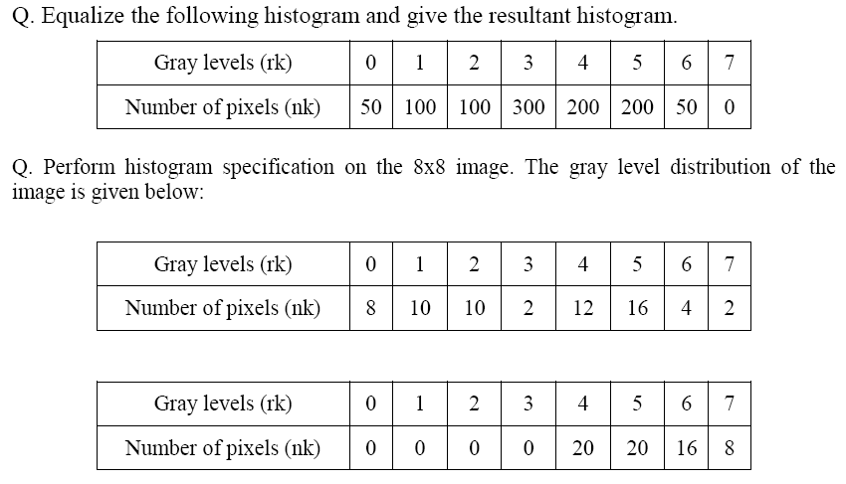
Assignment

Slide 72
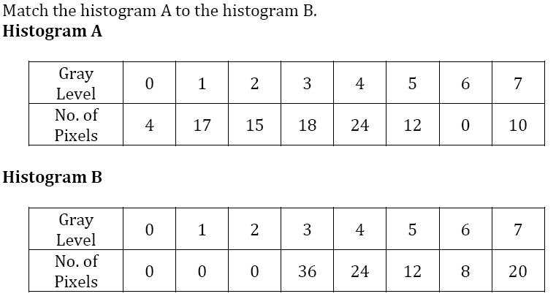
Assignment

Slide 73
Enhancement Using Arithmetic/Logic Operations
Arithmetic/Logic operations are performed on the pixels of two or more images.
Arithmetic: p and q are the pixel values at location (x,y) in first and second images respectively
Addition: p+q
Subtraction: p-q
Multiplication: p.q
Division: p/q

Slide 74
Logic Operations
When dealing with logic operations on gray-level images, pixel values are processed as strings of binary numbers.
AND, OR, COMPLEMENT (NOT)

Slide 75
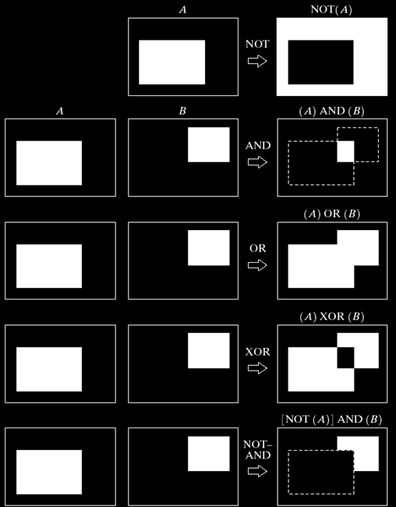

Slide 76
Example of AND Operation
original image
AND image
mask
result of AND operation

Slide 77
Image Subtraction
Obtained by computing the difference between all pairs of corresponding pixels from images f & h g(x,y)=f(x,y)-h(x,y)
Example: imaging blood vessels and arteries in a body. Blood stream is injected with a dye and X-ray images are taken before and after the injection
f(x,y): image after injecting a dye
h(x,y): image before injecting the dye
The difference of the 2 images yields a clear display of the blood flow paths.

Slide 78

Image Subtraction: Example
Enhancement by image subtraction

Slide 79



Image Subtraction: Example …

Slide 80
Image Averaging
A noisy image:
Averaging M different noisy images:
As M increases, the variability of the pixel values at each location decreases.
This means that g(x, y) approaches f(x, y) as the number of noisy images used in the averaging process increases.

Slide 81

Image Averaging: Example
Image of Galaxy3314,
Image corrupted by additive Gaussian Noise with zero mean and a standard deviation of 64 gray levels
c-f Results of averaging K=8,16,64 and 128 noisy images (Original image courtesy of NASA)

Slide 82

Image Averaging: Example

Slide 83

Spatial Filtering

Slide 84
Spatial Filtering
Enhancement techniques based on the pixels of an image are often referred to as Spatial filtering
Working in a neighbourhood of every pixel in an image
Filter term in “Digital image processing” is referred to the subimage
There are others term to call subimage such as mask, kernel, template, or window
The value in a filter subimage are referred as coefficients, rather than pixels.

Slide 85

Spatial Filtering

Slide 86
Mechanics of Spatial filtering
The process consists simply of moving the filter mask from point to point in an image.
At each point (x, y) the response of the filter at that point is calculated using a predefined relationship.
If the operation performed on the pixel is linear, then the filter is called linear spatial filter.

Slide 87
Mechanics of Spatial filtering
Origin
x
a
b
c
r
s
t
d
e
f
*
u
v
w
g
h
i
x
y
z
Original Image Pixels
Filter
Simple 3*3 Neighbourhood
e
3*3 Filter
e_{processed} = v*e + r*a + s*b + t*c + u*d + w*f + x*g + y*h + z*i
y
Image f (x, y)
The above is repeated for every pixel in the original image to generate the filtered image

Slide 88
Spatial Filtering Process
Simply move the filter mask from point to point in an image.
At each point (x,y), the response of the filter at that point is calculated using a predefined relationship.

Slide 89
In general, linear filtering of an image f of size M x N with a filter mask of size m x n is given by the expression:
where (as per the previous discussion)
a = (m – 1) / 2 & b = (n – 1) / 2
To generate a complete filtered image, the above equation must be applied for
x = 0, 1, …, M-1 & y = 0, 1, …, N-1

Slide 90
Smoothing Spatial Filters
Used for blurring and for noise reduction
Blurring is used in preprocessing steps, such as
removal of small details from an image prior to object extraction
bridging of small gaps in lines or curves
noise reduction can be accomplished by blurring with a linear filter and also by a nonlinear filter
There are 2 types of smoothing spatial filters
Smoothing Linear Filters
Order-Statistics Filters

Slide 91
Smoothing Linear Filters
Output is simply the average of the pixels contained in the neighborhood of the filter mask.
Also Called Averaging filters or Lowpass filters.
Replacing the value of every pixel in an image by the average of the gray levels in the neighborhood will reduce the “sharp” transitions in gray levels.
Sharp transitions
random noise in the image
edges of objects in the image
Thus, smoothing can reduce noises (desirable) and blur edges (undesirable)

Slide 92
Smoothing Linear Filters …
One of the simplest spatial filtering operations we can perform is a smoothing operation
Simply average all of the pixels in a neighbourhood around a central value
Especially useful in removing noise from images
Also useful for highlighting gross detail
¹/₉ | ¹/₉ | ¹/₉
¹/₉ | ¹/₉ | ¹/₉
¹/₉ | ¹/₉ | ¹/₉
Simple averaging filter

Slide 93
Smoothing Linear Filters …
Origin
x
104
100
108
¹/₉
¹/₉
¹/₉
99
106
98
*
¹/₉
¹/₉
¹/₉
95
90
85
¹/₉
¹/₉
¹/₉
Original Image Pixels
Filter
¹/₉
¹/₉
¹/₉
Simple 3*3 Neighbourhood
104
100
108
3*3 Smoothing Filter
¹/₉
¹/₉
¹/₉
99
106
98
¹/₉
¹/₉
¹/₉
95
90
85
e = ¹/₉*106 + ¹/₉*104 + ¹/₉*100 + ¹/₉*108 + ¹/₉*99 + ¹/₉*98 + ¹/₉*95 + ¹/₉*90 + ¹/₉*85
= 98.3333
y
Image f (x, y)
The above is repeated for every pixel in the original image to generate the smoothed image

Slide 94

3x3 Smoothing Linear Filters
Standard Average
weighted average
the center is the most important and other pixels are inversely weighted as a function of their distance from the center of the mask

Slide 95
Smoothing Linear Filters
The general implementation for filtering an M x N image with a weighted averaging filter of size m x n is given by the expression

Slide 96

Smoothing Linear Filters: Example

Slide 97

Smoothing Linear Filters: Example
Original image of 500 x 500 pixels
Results of smoothing with square averaging filter masks of size m=3, 5, 9,15 and 35 respectively
Note:
big mask is used to eliminate small objects from an image.
the size of the mask establishes the relative size of the objects that will be blended with the background.

Slide 98
Weighted Smoothing Filters
More effective smoothing filters can be generated by allowing different pixels in the neighbourhood different weights in the averaging function
Pixels closer to the central pixel are more important
Often referred to as a weighted averaging
¹/₁₆ | ²/₁₆ | ¹/₁₆
²/₁₆ | ⁴/₁₆ | ²/₁₆
¹/₁₆ | ²/₁₆ | ¹/₁₆
Weighted averaging filter

Slide 99
Order-Statistics Filters
Order-statistics filters are nonlinear spatial filters whose response is based on ordering (ranking) the pixels contained in the image area encompassed by the filter,
Example
median filter : R = median{z_{k} |k = 1,2,…,n x n}
max filter : R = max{z_{k} |k = 1,2,…,n x n}
min filter : R = min{z_{k} |k = 1,2,…,n x n}
note: n x n is the size of the mask

Slide 100
Process of Median filter
Crop region of neighborhood
Sort the values of the pixel in the region
In the M x N mask the median is (M x N div 2) +1
10
15
20
20
100
20
20
20
25
10, 15, 20, 20, 20, 20, 20, 25, 100
5th

Slide 101
Median Filtering
Median filtering is particularly effective in the presence of impulse noise (salt and pepper noise).
Unlike average filtering, median filtering does not blur too much image details.
Advantages:
Removes impulsive noise
Preserves edges
Disadvantages:
performance poor when # of noise pixels in the window is greater than 1/2 # in the window
performs poorly with Gaussian noise

Slide 102

Median Filtering: Example
X-ray image of circuit board corrupted by salt-pepper noise
Noise reduction with a 3 x 3 averaging mask
Noise reduction with a 3 x 3 median filter

Slide 103


Median Filtering: Example
Noise reduction with a 3 x 3 median filter

Slide 104

Sharpening Spatial Filters
The principal objective of sharpening is to highlight fine detail in an image or to enhance detail that has been blurred, either in error or as a natural effect of a particular method of image acquisition.
First and second order derivatives are commonly used for sharpening:

Slide 105
Blurring vs. Sharpening
As we know that blurring can be done in spatial domain by pixel averaging in a neighbors
since averaging is analogous to integration
Therefore, logically it can be concluded that the sharpening must be accomplished by spatial differentiation.

Slide 106
Derivative operator
The strength of the response of a derivative operator is proportional to the degree of discontinuity of the image at the point at which the operator is applied.
thus, image differentiation
enhances edges and other discontinuities (noise)
deemphasizes area with slowly varying gray-level values.

Slide 107

First-order derivative
a basic definition of the first-order derivative of a one-dimensional function f(x) is the difference

Slide 108

Second-order derivative
similarly, we define the second-order derivative of a one-dimensional function f(x) is the difference

Slide 109
Response of First and Second order derivatives
Response of first order derivative is:
zero in flat segments (area of constant grey values)
Non zero at the onset of a grey level step or ramp
Non zero along ramps
Response of second order derivative is:
Zero in flat areas
Non zero at the onset of a grey level step or ramp
Zero along ramps of constant slope

Slide 110

First and Second Order Derivatives: Example

Slide 111

First and Second Order Derivatives: Example …

Slide 112
First and Second Order Derivatives …
Analysis
The 1st-order derivative is nonzero along the entire ramp, while the 2nd-order derivative is nonzero only at the onset and end of the ramp.
Edges in an image represent this type (ramp) of transition. Therefore, 1st make thick edge and 2nd make thin, much finer edges
The response at and around the point is much stronger for the 2nd- than for the 1st-order derivative.

Slide 113
1st and 2nd Derivative Comparison
First-order derivatives generally produce thicker edges in an images.
Second-order derivatives have a stronger response to fine detail (e.g. thin lines or isolated points).
First-order derivatives generally have a stronger response to a gray-level step.
Second-order derivatives produce a double response at step changes in gray level

Slide 114

The Laplacian (Use of Second derivative for Enhancement)
The filter is expected to be isotropic: response of the filter is independent of the direction of discontinuities in an image.
Simplest 2-D isotropic second order derivative is the Laplacian:

Slide 115
2-Dimensional Laplacian
The digital implementation of the 2-Dimensional Laplacian is obtained by summing 2 components
0 | 1 | 0
1 | -4 | 1
0 | 1 | 0

Slide 116



Laplacian Masks

Slide 117
Effect of Laplacian Operator
as it is a derivative operator,
it highlights gray-level discontinuities in an image
it deemphasizes regions with slowly varying gray levels
tends to produce images that have
grayish edge lines and other discontinuities, all superimposed on a dark,
featureless background.

Slide 118



Image of the north pole of the moon

Slide 119
Strange Things Happen At The Edges!
At the edges of an image we are missing pixels to form a neighbourhood
Origin
x
e
e
e
e
e
e
e
y
Image f (x, y)

Slide 120
Strange Things Happen At The Edges …
There are a few approaches to dealing with missing edge pixels:
Omit missing pixels
Only works with some filters
Can add extra code and slow down processing
Pad the image
Typically with either all white or all black pixels
Replicate border pixels

Slide 121

Any Questions ?

